Slide 1
Mixture models and EM
Kyu Cho

Slide 2
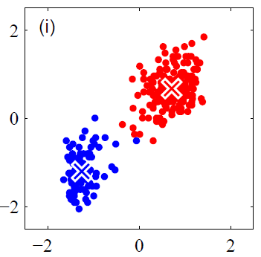
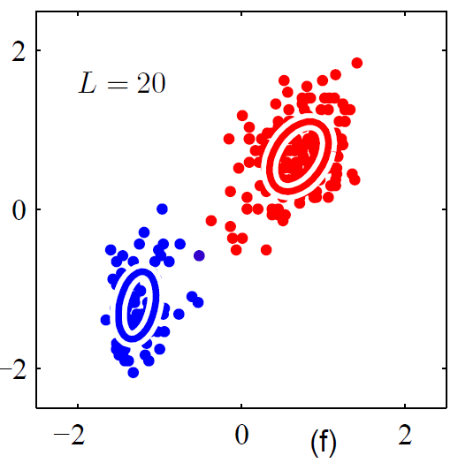
Mixture Models
Hard Clustering : clusters do not overlap
ex) cluster 1 or 2
Soft Clustering : clusters may overlap
Each cluster is presented as probability distribution.
ex) 60% of cluster 1, 40% of cluster 2

Slide 3
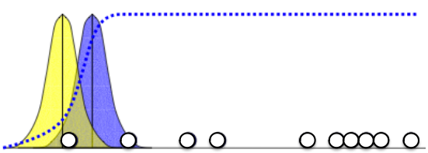
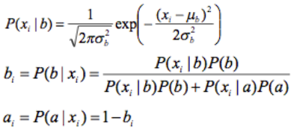
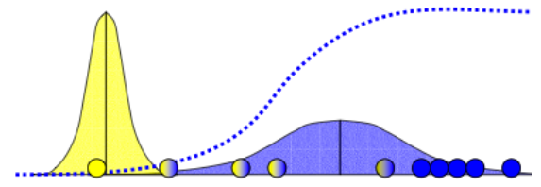
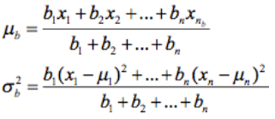
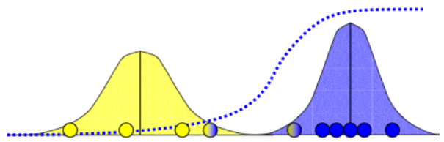
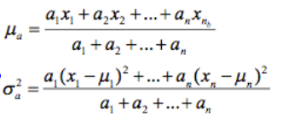
Mixture Model in 1-d

Slide 4

How to pick K?
Probabilistic model
- tries to “fit” the data (maximize likelihood)
Pick K that makes L as large as possible
Set threshold to stop the iteration

Slide 5
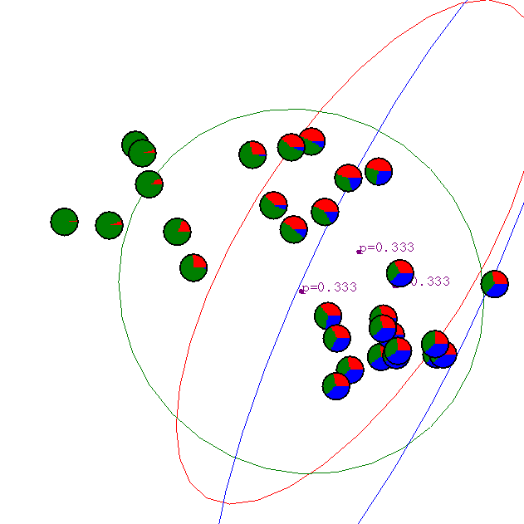
Gaussian Mixture Example: Start

Slide 6
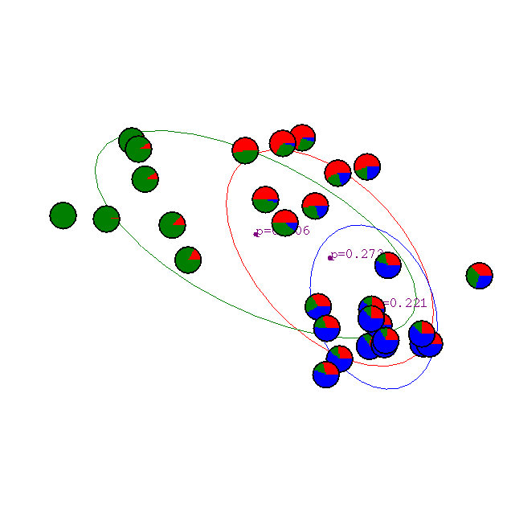
1st iteration

Slide 7

2nd iteration

Slide 8

3rd iteration

Slide 9

4th iteration

Slide 10

5th iteration

Slide 11

6th iteration

Slide 12

20th iteration

